Slide 1


GLOBAL ACADEMY OF TECHNOLOGY DEPARTMENT OF COMPUTER SCIENCE AND ENGINEERING (Accredited by NBA 2019-2022) Academic Year : 2019 - 20 EVEN Sem
Subject Name | Project Work | Subject Code | 15CSP85
Student Name | PRAVEEN V | USN | 1GA16CS101
 | YASHAS C R |  | 1GA16CS182
 | THEJASVEE M |  | 1GA16CS195
 | SNEHA SURENDRA |  | 1GA16CS198
Domain | DEEP LEARNING | Group No: | 53
Project Title | “ EXPERT SYSTEMS FOR DIFFERENTIAL DIAGNOSIS USING DEEP LEARNING ”
Under taken at | GLOBAL ACADEMY OF TECHNOLOGY
Guide Name | JYOTHI R

Slide 2
Agenda
Objectives
Problem statement
Architecture Diagram
Module Split-ups and algorithms used
Implementation

Slide 3
Objectives
To set up an environment that records the patient’s history and symptoms and analyses the condition.
Diagnose the symptoms causing almost all kind of liver diseases
And finally, to predict the most probable diseases by which liver is affected.

Slide 4
Problem Statement
Develop an automated diagnosing system for patients provided with the patient’s conditions, test results and history and listing out accurately the most appropriate diseases causing the symptoms which can improve the rate of diagnosing drastically, increase the probability of permanent cure and thus saving millions of life.

Slide 5
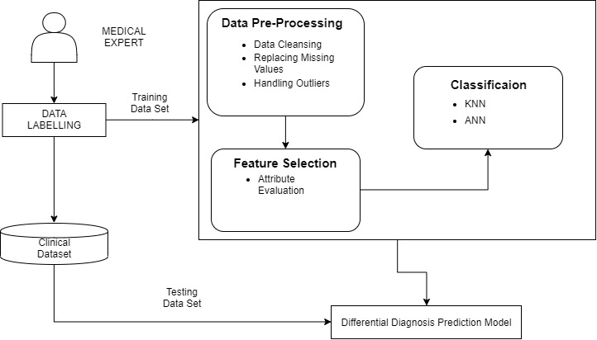
Architecture Diagram of the project

Slide 6
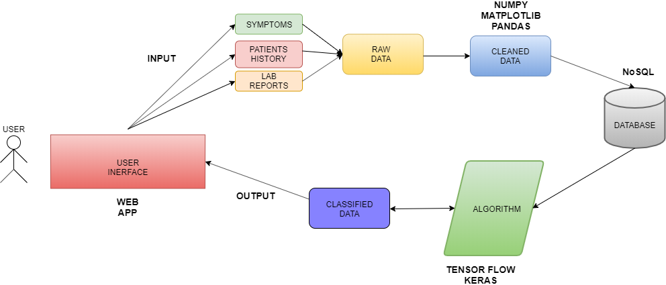
FLOW DIAGRAM

Slide 7
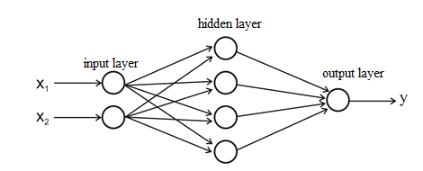
Modules
Database
Collection of Raw Data
Data Cleaning
Modelling
Algorithms- Feed Forward Network-ANN Back Propagation-KNN.
Output
Web Interface for the User.

Slide 8
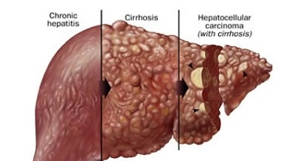
Collection of Raw Data
This phase consists of collecting the data and organising it .
Finding out the symptoms for the diseases and considering them as attributes.
Cirrhosis:- It is the late stage of scarring (fibrosis) of the liver caused by many forms of liver diseases and conditions, such as hepatitis and chronic alcoholism.
Hepatocellular carcinoma (HCC):-The most common type of primary liver cancer which occurs most often in people with chronic liver diseases, such as cirrhosis caused by hepatitis.
Dataset acquired from UCI and Kaggle websites
LFT(Liver Function Test) lab reports of some patients acquired from diagnostic centers.

Slide 9
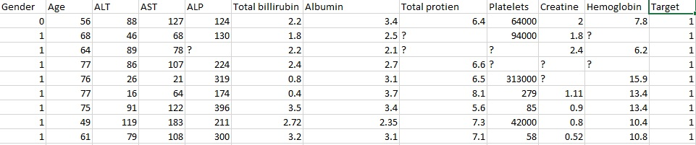
Data Cleaning
The symptoms and the history of patients from the datasets of cirrhosis and HCC were separated from their lab report values.
The null values(‘?’) in the data were replaced by their normal range or their average values using numpy library.
The common attributes in the symptoms of cirrhosis and HCC were combined together and similarly the same was done for lab reports.

Slide 10
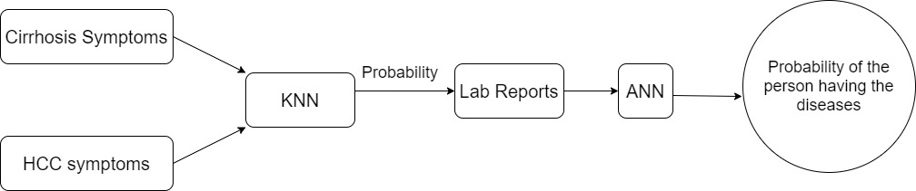
Implementation
The symptoms dataset is fed for the KNN algorithm to predict which of the 2 diseases is most probable.
Later using this result, the diagnosed disease lab report data is fed to the ANN algorithm to predict at what probability he/she might have this disease.

Slide 11
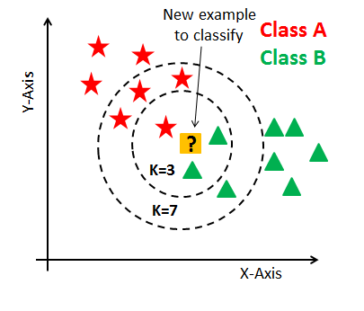
Algorithm-KNN(K-Nearest Neighbors)
The KNN algorithm assumes that similar things exist in close proximity. In other words, similar things are near to each other.
Target values assigned:
0: Normal condition of the liver
1: Has HCC
2: Has cirrhosis
The common symptoms are fed to KNN algorithm to determine the target value and predict the disease.

Slide 12
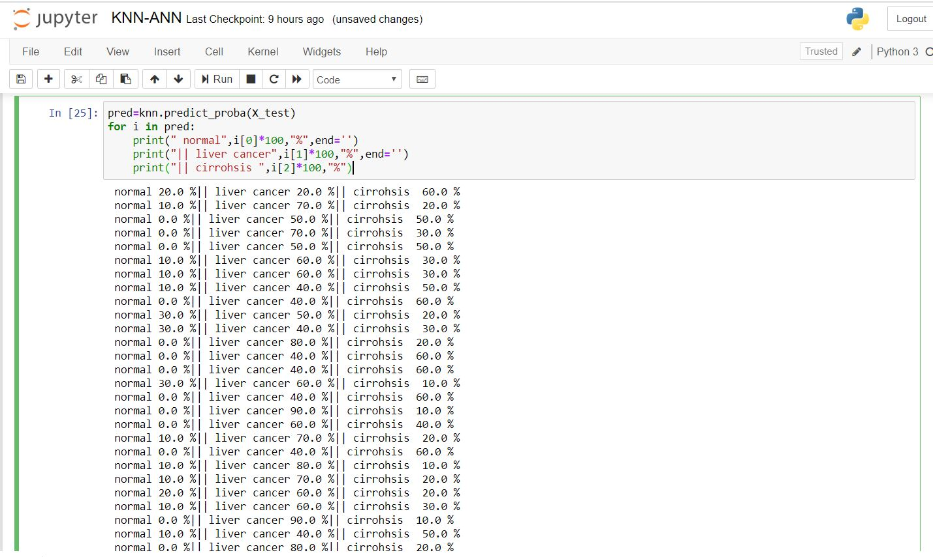
KNN Implementation
The above image shows the 1st level implementation using KNN on the dataset and list out the probability of the diseases suffered by the patient.

Slide 13
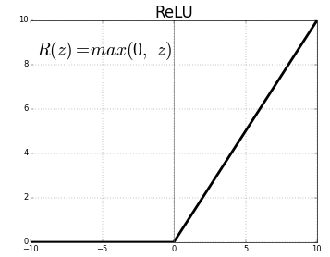
Algorithm-ANN
Keras is a simple tool for constructing a neural network. It is a high-level framework based on tensorflow.
Sequential specifies to keras that we are creating model sequentially and the output of each layer we add is input to the next layer we specify.
Relu is an activation function that stands for rectified linear unit, and is a type of activation function. Mathematically, it is defined as y = max(0, x).
The ANN algorithm helps us to predict at what probability he/she might get this disease after the result is obtained from the target value given by KNN algorithm.

Slide 14
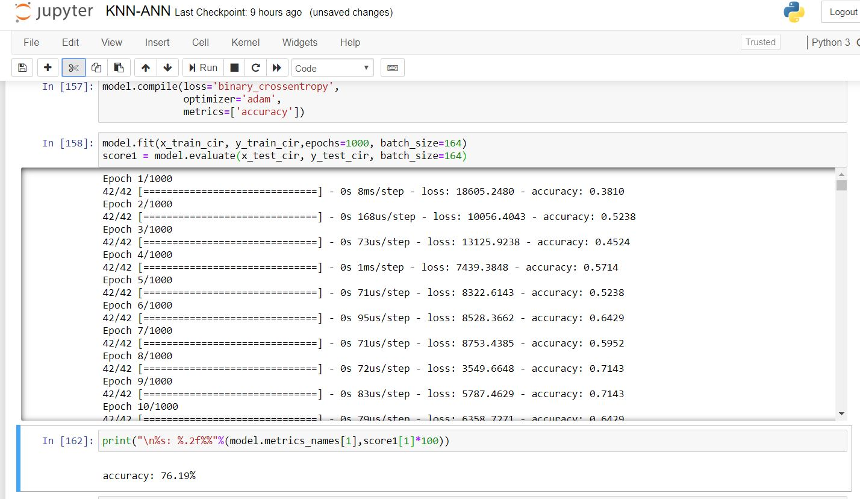
ANN Implementation
The above image shows 2nd level implementation using ANN on the previously obtained result and lists the probabilities of the diseases with more accuracy.

Slide 15
UI(User interface)
Develop a platform for the users to input the data

Slide 16
Thank You

Slide 17
Q & A

